Slide 1

Clustering for Text Similarity

Slide 2
Contents
Clustering Overview
Clustering for Text Similarity
Distance Metrics for Text
K-Means Clustering
Hierarchical Clustering
Density-based Clustering
Text Pre-Processing for Clustering

Slide 3
Clustering Overview
Concept
  Clustering is a process in which data points are grouped together based on their similarities or distances in a multi-dimensional space.
  The goal of clustering is to find natural groupings or patterns within a dataset, allowing similar data points to belong to the same cluster while being distinct from other clusters.

Slide 4
Clustering Overview
Significance of Clustering in Unstructured Data
  Clustering is particularly significant when dealing with unstructured data, such as text, images, or other forms of data where the underlying structure is not explicitly defined.
  In unstructured data, patterns and relationships are often hidden, making it challenging to organize and extract meaningful insights.
  Clustering helps uncover these hidden patterns by grouping similar data points together, enabling the identification of categories, topics, trends, or groups that may not be immediately apparent.

Slide 5
Clustering for Text Similarity
How Clustering Algorithms Group Similar Text Documents
  Vector Representation: Each text document is represented as a numerical vector in a high-dimensional space. Common methods include using term frequency-inverse document frequency (TF-IDF) or word embeddings to convert words into numerical values.
  Distance Calculation: Clustering algorithms compute the distance between document vectors to determine their similarity. Documents with smaller distances are considered more similar to each other.
  Assignment to Clusters: The algorithm assigns each document to the cluster with the nearest centroid (average vector) or based on a similarity threshold. Documents that are closer in vector space are grouped together.
  Iterative Refinement: Depending on the algorithm, the process might be iterative. The centroids are recalculated, documents are reassigned, and the clusters are refined in each iteration.

Slide 6
Clustering for Text Similarity
Role of Distance Metrics in Measuring Text Similarity
  Euclidean Distance: Measures the straight-line distance between two vectors in the space. It's sensitive to differences in both magnitude and direction.
  Cosine Similarity: Measures the cosine of the angle between two vectors. It's often used with TF-IDF vectors and is insensitive to vector magnitude.
  Jaccard Similarity: Measures the size of the intersection of two sets divided by the size of their union. It's often used for measuring similarity between sets of words.
  Pearson Correlation: Measures the linear correlation between two vectors. It captures both magnitude and direction.

Slide 7
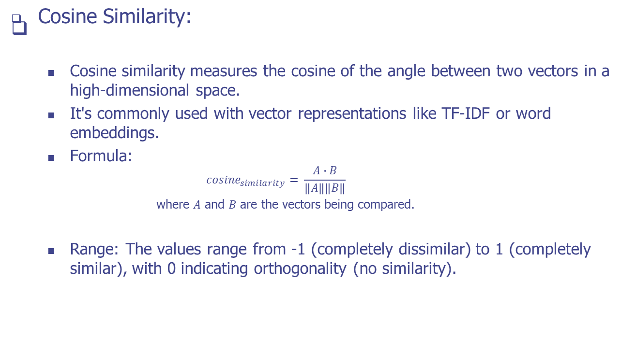
Distance Metrics for Text

Slide 8
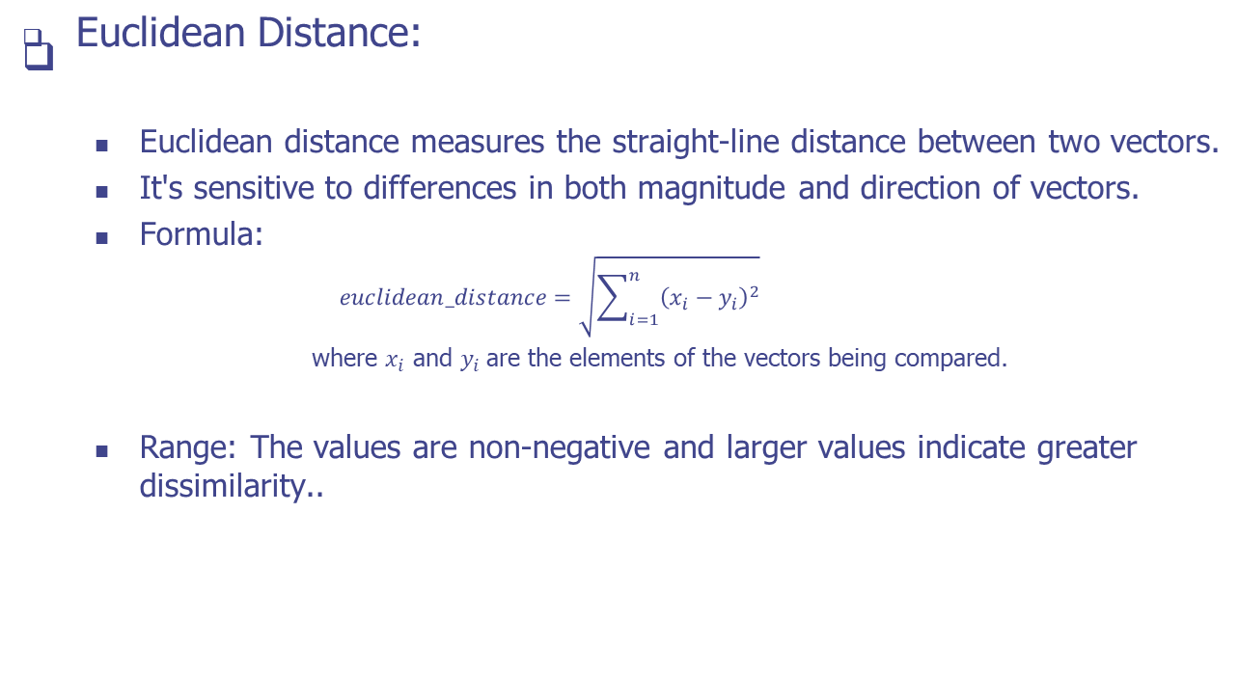
Distance Metrics for Text

Slide 9
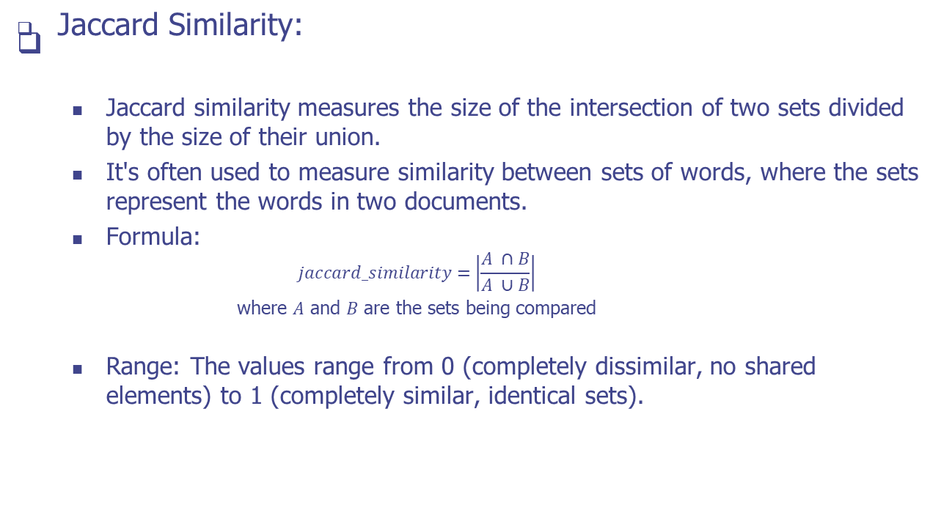
Distance Metrics for Text

Slide 10
K-Means Clustering
Concept
  K-Means clustering is a widely used unsupervised machine learning algorithm for partitioning a dataset into a predetermined number of clusters. It's particularly useful for text clustering, where the goal is to group similar text documents into distinct clusters based on their content.
Avantages of K-Means
  K-Means is simple, easy to understand, and computationally efficient, making it suitable for large datasets.
  It's effective for cases where clusters are spherical and similarly sized.
  It provides insights into data grouping and can help uncover patterns within text data.

Slide 11
K-Means Clustering
Basic Steps of the K-Means Algorithm
  Choose the Number of Clusters (K): The first step is to specify the number of clusters you want the algorithm to partition the data into.
  Initialize Cluster Centroids: Randomly select K data points as initial cluster centroids. Each centroid represents the center of a cluster.
  Assign Data Points to the Nearest Centroid:
    For each data point, calculate the distance (using a distance metric like Euclidean distance or cosine similarity) to each of the K centroids.
    Assign the data point to the cluster whose centroid is the nearest (minimizing the distance).
  Update Centroids: After all data points are assigned to clusters, recalculate the centroids of each cluster by computing the mean of all data points assigned to that cluster.
  Repeat Until Convergence: Steps 3 and 4 are repeated iteratively until the centroids no longer change significantly or a predefined number of iterations is reached

Slide 12
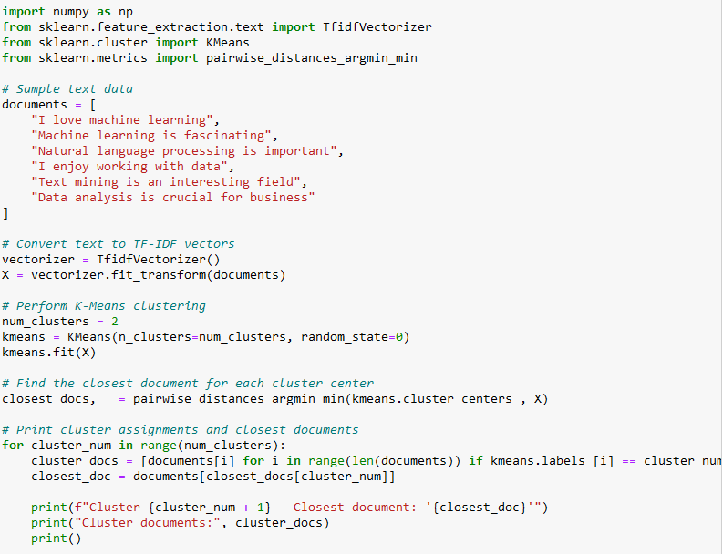
Example
In this example:
We have a sample dataset of text documents.
We use the TfidfVectorizer to convert the text documents into TF-IDF vectors, which is a common approach for representing text data.
We perform K-Means clustering on the TF-IDF vectors using the KMeans class from scikit-learn.
We find the closest document to each cluster center using pairwise_distances_argmin_min.
Finally, we print the cluster assignments along with the closest document for each cluster.

Slide 13
Hierarchical Clustering
Concept
  Hierarchical clustering is a method used to create a hierarchy of clusters in a dataset.
  Unlike K-Means, which requires specifying the number of clusters beforehand, hierarchical clustering builds a tree-like structure of clusters, allowing for more nuanced insights into data relationships.
  It doesn't just assign data points to clusters; it arranges them in a hierarchy that can be visualized as a dendrogram.

Slide 14
Hierarchical Clustering
Agglomerative and Divisive Hierarchical Clustering
  Agglomerative (Bottom-Up):
    Agglomerative hierarchical clustering starts by treating each data point as an individual cluster.
    It iteratively merges the closest clusters into larger ones, moving up the hierarchy until all data points belong to a single cluster.
  Divisive (Top-Down):
    Divisive hierarchical clustering starts with all data points in a single cluster.
    It recursively divides the clusters into smaller ones, moving down the hierarchy until each data point forms its own cluster.

Slide 15
Hierarchical Clustering
Hierarchical Clustering Process
  Compute the pairwise distances between data points.
  Treat each data point as a single cluster.
  Combine the closest two clusters (or split the largest cluster) based on the chosen linkage method.
  Recalculate distances between the new cluster(s) and the remaining clusters.
  Repeat steps 3 and 4 until all data points are in a single cluster (agglomerative) or each data point is its own cluster (divisive).

Slide 16
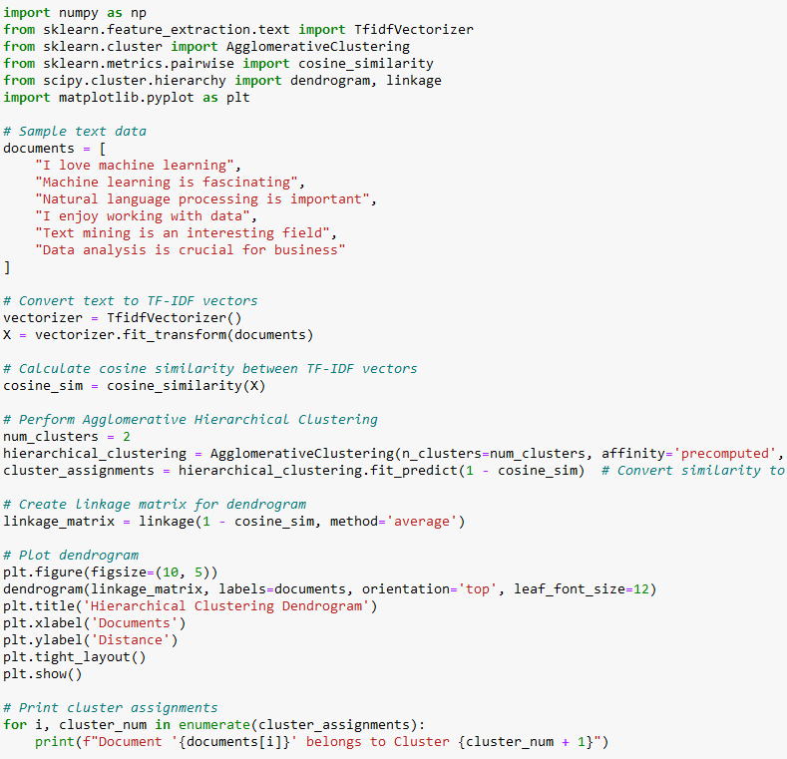
Example
In this example:
We have a sample dataset of text documents.
We use the TfidfVectorizer to convert the text documents into TF-IDF vectors.
We calculate the cosine similarity between the TF-IDF vectors using cosine_similarity.
We perform hierarchical clustering using the AgglomerativeClustering class from scikit-learn with the cosine similarity matrix.
We create a linkage matrix using the linkage function from scipy.cluster.hierarchy to visualize the dendrogram.
We plot the dendrogram to visualize the hierarchical clustering process.
We print the cluster assignments for each document.

Slide 17
Density-based Clustering
Concept
  Density-Based Spatial Clustering of Applications with Noise (DBSCAN) is a popular density-based clustering algorithm used to discover clusters of arbitrary shapes in datasets.
  Unlike K-Means or hierarchical clustering, which assume that clusters have similar sizes and shapes, DBSCAN can identify clusters with varying shapes and densities.

Slide 18
Density-based Clustering
DBSCAN Groups Data Points
  The algorithm classifies data points into three categories:
  Core Points:
    A core point is a data point that has a minimum number of neighboring points (specified by the "minPts" parameter) within a specified radius ("eps").
    Core points are central to clusters and form the starting points for building clusters.
  Border Points:
    A border point is a data point that has fewer neighboring points than "minPts" within the radius "eps" but falls within the radius of a core point.
    Border points are on the edges of clusters and can connect clusters if they are near multiple core points.
  Noise Points (Outliers):
    A noise point (outlier) is a data point that is neither a core nor a border point.
    Noise points are considered to be part of no cluster and are often considered as unstructured or less relevant data.

Slide 19
Density-based Clustering
DBSCAN Clustering Process
  Select Parameters: Choose the "eps" (distance threshold) and "minPts" (minimum number of neighboring points) parameters.
  Identify Core Points: Identify core points by finding data points with at least "minPts" neighbors within distance "eps."
  Expand Clusters: For each core point:
    Form a cluster by including the core point and all directly reachable points (core and border) within distance "eps."
    Recursively expand the cluster by adding additional core and border points.
  Label Border and Noise Points: Label border points as part of the cluster but not core points. Label noise points as outliers.
  Repeat for All Data Points: Iterate through all data points, forming clusters and labeling points based on connectivity.

Slide 20
Text Pre-Processing for Clustering
Importance of Text Preprocessing for Clustering
  Text preprocessing is a crucial step in text clustering that involves cleaning and transforming raw text data into a format that is more suitable for analysis.
  Effective preprocessing enhances the quality of clustering results by reducing noise, standardizing representation, and improving the accuracy of text similarity measurements.

Slide 21
Text Pre-Processing for Clustering
Techniques in Text Preprocessing
  Tokenization
  Tokenization breaks text into individual words or tokens. It's a fundamental step that forms the basis for text analysis.
  Stop Word Removal
  Stop words are common words (e.g., "and," "the," "is") that don't carry much meaning. Removing them reduces the dimensionality of the data and focuses on more meaningful terms..

Slide 22
Text Pre-Processing for Clustering
Techniques in Text Preprocessing
  Stemming and Lemmatization
  Stemming reduces words to their base or root form (e.g., "running" to "run"). Lemmatization goes a step further by converting words to their dictionary or lemma form.
  TF-IDF Vectorization
  TF-IDF (Term Frequency-Inverse Document Frequency) represents words as numerical values, considering both their frequency in a document and their importance across the corpus.

Slide 23
Text Pre-Processing for Clustering
Enhancing Clustering Results through Preprocessing
  Noise Reduction
  Preprocessing removes irrelevant or redundant information, reducing noise that can interfere with the identification of meaningful patterns and clusters.
  Standardization
  Preprocessing ensures that text data is standardized, making clustering algorithms more effective. Different forms of the same word (e.g., "running" and "runs") are treated consistently, improving text similarity measurement.
  Dimensionality Reduction
  Techniques like stop word removal and stemming reduce the dimensionality of the data. This helps in handling high-dimensional text spaces and reducing computational complexity.

Slide 24
Text Pre-Processing for Clustering
Enhancing Clustering Results through Preprocessing
  Focus on Semantic Meaning:
  Preprocessing refines the text by removing stop words and transforming words to their base forms. This helps clustering algorithms focus on semantic meaning rather than noise.
  Enhanced Similarity Calculation:
  Techniques like TF-IDF vectorization capture the importance of words in documents, leading to more accurate text similarity measurements during clustering.

Slide 25
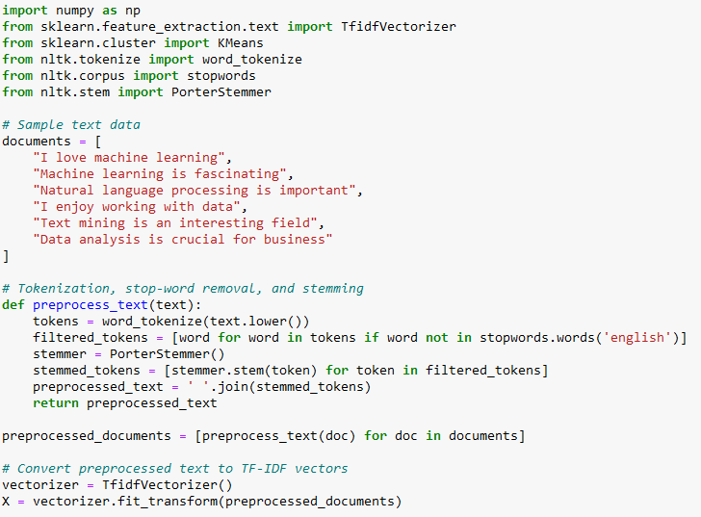
Example
In this example:
We have a sample dataset of text documents.
We define a function preprocess_text to perform tokenization, stop-word removal, and stemming using NLTK library.
We preprocess the text documents using this function.
We use the TfidfVectorizer to convert the preprocessed text documents into TF-IDF vectors.

Slide 26
Practice
Instructions
  Create a Python program that performs text similarity clustering on a more challenging dataset.
  You'll work with a larger dataset of text documents and perform pre-processing, vectorization, and clustering to group similar documents
Dataset
  documents = [
    "Machine learning techniques are used in artificial intelligence applications.",
    "Natural language processing is a subfield of artificial intelligence.",
    "Data mining and machine learning are used to analyze large datasets.",
    "Deep learning models have achieved state-of-the-art results in various tasks.",
    "Text classification is a common application of natural language processing.",
    "Recommendation systems use machine learning to suggest relevant items.",
    "Sentiment analysis aims to determine the sentiment expressed in text data.",
    "Clustering algorithms group similar data points together.",
    "Supervised learning requires labeled training data.",
    "Unsupervised learning explores patterns in unlabeled data.",
    "Reinforcement learning is used to train agents in dynamic environments.“
  ]

Slide 27
Practice
Tasks
  Task 1: Text Pre-Processing
    Write a function preprocess_text(text) that takes a text document as input and performs tokenization, lowercase conversion, stop-word removal, and stemming using NLTK.
  Task 2: Text Vectorization
    Write a function vectorize_text(documents) that takes a list of pre-processed documents as input and converts them into TF-IDF vectors using the TfidfVectorizer from scikit-learn.
  Task 3: Perform Clustering
    Write a function perform_clustering(X, num_clusters) that takes the TF-IDF vectors and the number of clusters as input. Perform K-Means clustering using the KMeans class from scikit-learn.
  Task 4: Print Cluster Assignments
    Write a function print_cluster_assignments(cluster_assignments, documents) that takes the cluster assignments and the original documents as input and prints the cluster assignments for each document.
  Task 5: Evaluate Clustering Results
    Write a function evaluate_clustering(cluster_assignments) that takes the cluster assignments as input and calculates the silhouette score to evaluate the quality of clustering.
  Task 6: Test Your Functions
    Apply each function to the provided dataset and demonstrate the text similarity clustering process. Print the cluster assignments and the silhouette score.

Slide 28
Q & A

